Slide 1


BRAND IDENTITY · 2026
Make the invisible
actionable.
A clear, confident identity system for TurnKey Instruments.
PREPARED BY LOCAL & CO
Notes:
Introduce the identity as an evolution: the trusted TurnKey mark remains unchanged while the surrounding system becomes clearer, lighter and more modern.
[Sources]
- /Users/kristinkirchner/Library/CloudStorage/OneDrive-LocalandCo/Projects/Brand CI/TurnKey Brand Hub/public/brand/turnkey-logo.png
- /Users/kristinkirchner/Library/CloudStorage/OneDrive-LocalandCo/Projects/Brand CI/TurnKey Brand Hub/public/photography/field-monitoring-quarry.png
[/Sources]

Slide 2
THE OPPORTUNITY
02 / 22
WHY NOW
A specialist range deserves a clearer story.
TurnKey already has strong recognition, distinctive yellow and a broad portfolio. The opportunity is to make that expertise easier to navigate and more consistent at every point of contact.
01
02
03
Protect what is recognised
Clarify what is complex
Modernise how it works
The logo and core colour remain familiar.
A broad range becomes four useful product doors.
A lighter system improves digital, sales and field communication.
Notes:
Frame the refresh as a practical business tool: it improves recognition, navigation and presentation without redesigning the logo.
[Sources]
- https://turnkey-instruments.com/
- /Users/kristinkirchner/Library/CloudStorage/OneDrive-LocalandCo/Projects/Brand CI/TurnKey Brand Hub/public/brand/turnkey-logo.png
[/Sources]

Slide 3
BRAND IDEA
03 / 22
THE ORGANISING THOUGHT
Make the invisible
actionable.
TurnKey instruments reveal conditions that cannot always be seen. The identity follows the same logic: it makes information clear, evidence useful and the next action obvious.
01
02
03
04
→
→
→
Condition
Measurement
Insight
Action
Notes:
Use this line as a creative filter. Every application should help people move from a condition, through measurement and insight, to action.
[Sources]
- https://turnkey-instruments.com/
[/Sources]

Slide 4
DESIGN RESPONSE
04 / 22
WHY THIS WORKS FOR TURNKEY
Evolution without losing recognition.
01
02
03
04
The logo stays familiar
Yellow gains impact
The range becomes clearer
Physical and digital connect
Modernisation comes from space, scale and structure around the mark.
Using it with intent gives actions and emphasis more energy.
Icons and consistent product stories make the portfolio easier to understand.
A restrained blue bridges instruments, data and interaction.
Notes:
Emphasise that the design value is in the complete support system, not a replacement mark.
[Sources]
- /Users/kristinkirchner/Library/CloudStorage/OneDrive-LocalandCo/Projects/Brand CI/TurnKey Brand Hub/public/brand/turnkey-logo.png
[/Sources]

Slide 5
FOUNDATIONS · LOGO
05 / 22
RECOGNITION FIRST
The TurnKey logo remains unchanged.
Its distinctive wordmark and yellow signal already carry brand equity. The refreshed identity creates more room, confidence and consistency around it.
UNCHANGED MASTER
Notes:
Confirm that no new mark has been created. Always use the supplied logo master without redrawing, recolouring or altering proportions.
[Sources]
- /Users/kristinkirchner/Library/CloudStorage/OneDrive-LocalandCo/Projects/Brand CI/TurnKey Brand Hub/public/brand/turnkey-logo.png
[/Sources]

Slide 6
FOUNDATIONS · LOGO USE
06 / 22
USE WITH CONFIDENCE
Give the mark room to lead.
DO
DON’T
Do not recolour, stretch, crop, outline or combine the logo with range icons.
Use generous clear space, high contrast and the master artwork.
01
Minimum digital width: 120 px
02
Prefer white, Cloud or very pale blue fields
03
Treat icons as navigation, not as logo extensions
Notes:
The minimum digital width is part of this approved operating system. For print, use reproduction tests appropriate to the production method.
[Sources]
- /Users/kristinkirchner/Library/CloudStorage/OneDrive-LocalandCo/Projects/Brand CI/TurnKey Brand Hub/public/brand/turnkey-logo.png
[/Sources]

Slide 7
FOUNDATIONS · COLOUR
07 / 22
A BRIGHTER, MORE USEFUL PALETTE
Recognition, connection and room to breathe.
Signal Yellow
Signal Blue
Carbon
Cloud
White
#FBCB14
#1967D2
#141414
#F4F4F1
#FFFFFF
ACTION + EMPHASIS
CONNECTED + DIGITAL
PRIMARY TYPE
CALM BACKGROUNDS
SPACE + CLARITY
Yellow remains the recognisable signal. Blue is added with restraint to clarify connected experiences, not to make the brand feel more technical.
Notes:
Signal Yellow is retained from the existing identity direction. Signal Blue is the supporting colour for connected states, links and digital utility.
[Sources]
- /Users/kristinkirchner/Library/CloudStorage/OneDrive-LocalandCo/Projects/Brand CI/TurnKey Brand Hub/public/brand/turnkey-logo.png
[/Sources]

Slide 8
FOUNDATIONS · COLOUR ROLES
08 / 22
COLOUR WITH A JOB
Use less colour to create more impact.
Signal Yellow
Primary actions, priority markers and physical response.
Signal Blue
Links, connected states, reporting and digital selection.
Carbon
Headlines, body copy, dividers and primary information.
Cloud + White
The dominant canvas for a clean, modern and confident brand.
90% LIGHT SPACE
The visual impression should stay light, open and product-led.
Notes:
Use this slide to avoid a dark, generic technology aesthetic. Most compositions should remain white, Cloud or pale blue.
[Sources]
- /Users/kristinkirchner/Library/CloudStorage/OneDrive-LocalandCo/Projects/Brand CI/TurnKey Brand Hub/public/brand/turnkey-logo.png
[/Sources]

Slide 9
FOUNDATIONS · TYPOGRAPHY
09 / 22
IBM PLEX
Technical confidence, human clarity.
Aa
01
DISPLAY
48–64
SECTION
34–46
SUBHEAD
20–26
IBM Plex Sans
IBM Plex Mono
15–19
BODY
Headlines, body copy and interface text. Clear at scale and practical in dense information.
Labels, metadata, measurements and structured navigation. Use sparingly for precision.
UTILITY
9–12
Use sentence case. Keep line lengths comfortable. Let whitespace do part of the work.
Notes:
IBM Plex Sans is the primary family; IBM Plex Mono is a supporting utility face. Both are distributed under the SIL Open Font License.
[Sources]
- https://github.com/IBM/plex
[/Sources]

Slide 10
FOUNDATIONS · LAYOUT
10 / 22
A CALIBRATED LAYOUT SYSTEM
Structure makes technical content feel simple.
8 px
Base spacing unit
01
02
03
04
05
06
07
08
09
10
11
12
One clear
reading priority.
12
Flexible columns
01
Primary message per view
Twelve columns. Generous margins. Flexible modules. Consistent rhythm.
40–72
Comfortable outer margins
Notes:
The grid is intentionally flexible. The rule is not symmetry for its own sake; the rule is one clear reading priority and consistent alignment.
[Sources]
[/Sources]

Slide 11
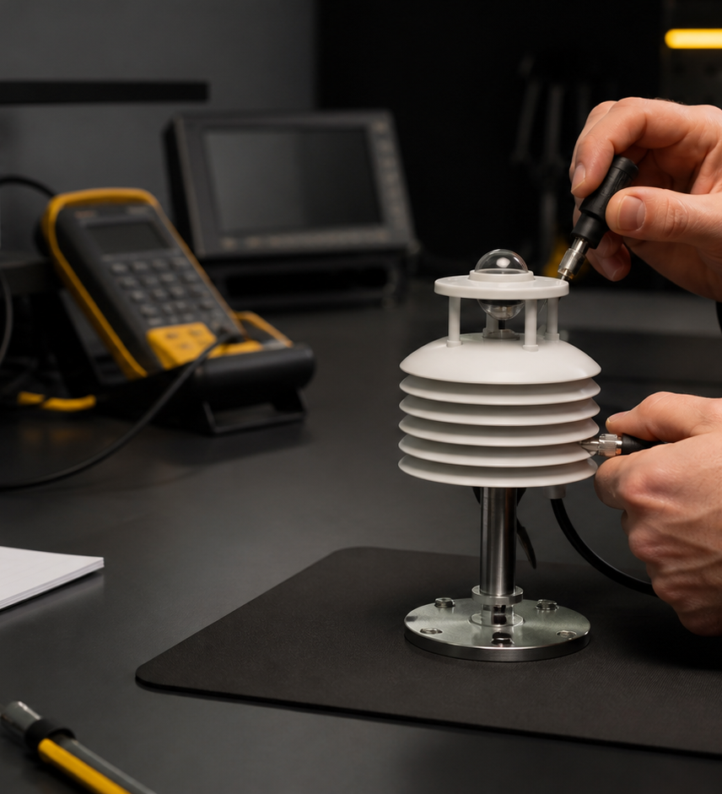
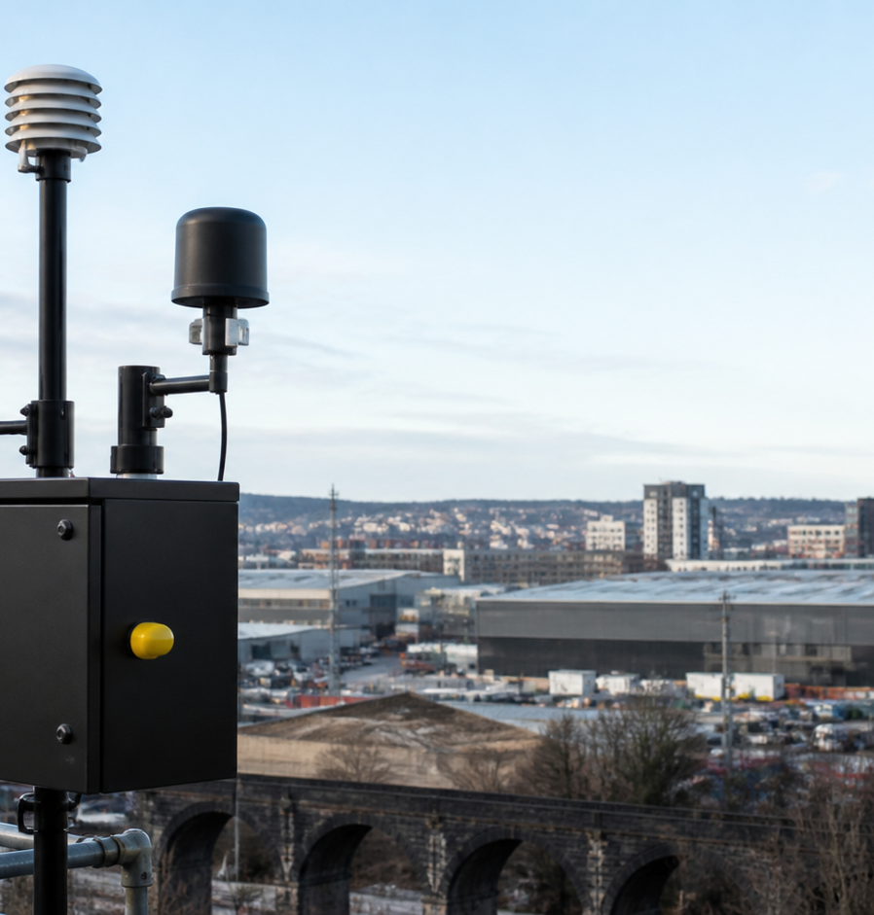
EXPRESSION · PHOTOGRAPHY
11 / 22
EVIDENCE IN CONTEXT
Show the condition. Show the action.
01
Real environments
02
Human expertise
03
Instrument detail
Use controlled natural light, decisive crops and honest settings. Keep enough quiet space for useful product information.
Notes:
Photography should feel observed and purposeful, not posed. Product accuracy and credible working context remain essential.
[Sources]
- /Users/kristinkirchner/Library/CloudStorage/OneDrive-LocalandCo/Projects/Brand CI/TurnKey Brand Hub/public/photography/field-monitoring-quarry.png
- /Users/kristinkirchner/Library/CloudStorage/OneDrive-LocalandCo/Projects/Brand CI/TurnKey Brand Hub/public/photography/calibration-lab.png
- /Users/kristinkirchner/Library/CloudStorage/OneDrive-LocalandCo/Projects/Brand CI/TurnKey Brand Hub/public/photography/air-monitoring-urban.png
[/Sources]

Slide 12
EXPRESSION · ICONOGRAPHY
12 / 22
A VISUAL SHORTHAND FOR THE RANGE
One clear symbol for every role.
Air + particulate
Gas
Noise
Vibration
Brake testing
Vehicle compliance
Connected data
Alerts
Reporting
Calibration
Service
Resources
Graphite is the default. Yellow identifies physical action; blue identifies connected moments. Icons always appear with a label and never form part of the logo.
Notes:
The support system uses a consistent 1.5–1.65 px open line style. Meanings remain stable across the brand hub, presentations and product communication.
[Sources]
- https://lucide.dev/
- /Users/kristinkirchner/Library/CloudStorage/OneDrive-LocalandCo/Projects/Brand CI/TurnKey Brand Hub/public/licences/Lucide-LICENSE.txt
[/Sources]

Slide 13
EXPRESSION · GRAPHIC LANGUAGE
13 / 22
SIGNALS WITH A JOB
From reading to response.
Lines, ticks, markers and readouts guide attention, show progression and bring order to technical information.
CONDITION
MEASUREMENT
INSIGHT
ACTION
Use these devices functionally. They should clarify, not decorate.
Notes:
The graphic language echoes measurement without mimicking a specific instrument display or inventing data.
[Sources]
[/Sources]

Slide 14
EXPRESSION · VOICE + TONE
14 / 22
HOW TURNKEY SOUNDS
Calm. Exact. Capable. Field-aware.
CALM
EXACT
CAPABLE
FIELD-AWARE
Confident without noise.
Specific product, use and evidence.
Practical expertise in every line.
Grounded in real working conditions.
CONDITION
See particulate conditions as they change.
EXPLORE THE RANGE
TurnKey monitoring solutions help teams understand changing particulate conditions and choose the right response for the site.
Start with the condition. Use a concrete verb. Make the next step clear.
Notes:
Use one practical idea per sentence. Avoid inflated claims, unnecessary jargon and generic technology language.
[Sources]
- https://turnkey-instruments.com/
[/Sources]

Slide 15
PRODUCT SYSTEM · ARCHITECTURE
15 / 22
ONE RANGE. FOUR OPERATIONAL OUTCOMES.
Built around the job.
9 PRODUCTS
4 PRODUCTS
Environmental monitoring
Connected data + response
Measure changing site, air, gas, noise and vibration conditions.
Connect, analyse, report and act on environmental readings.
9 PRODUCTS
2 PRODUCTS
Brake testing
Vehicle compliance + investigation
Test brake performance across road, fleet, agricultural and off-road use.
Support window-tint, skid and accident-investigation workflows.
This architecture makes the portfolio easier to browse while preserving every product’s exact name and technical role.
Notes:
The current public catalogue contains 24 products. Family labels organise the range for navigation; product names remain as published.
[Sources]
- https://turnkey-instruments.com/wp-json/wc/store/v1/products?per_page=100
[/Sources]

Slide 16
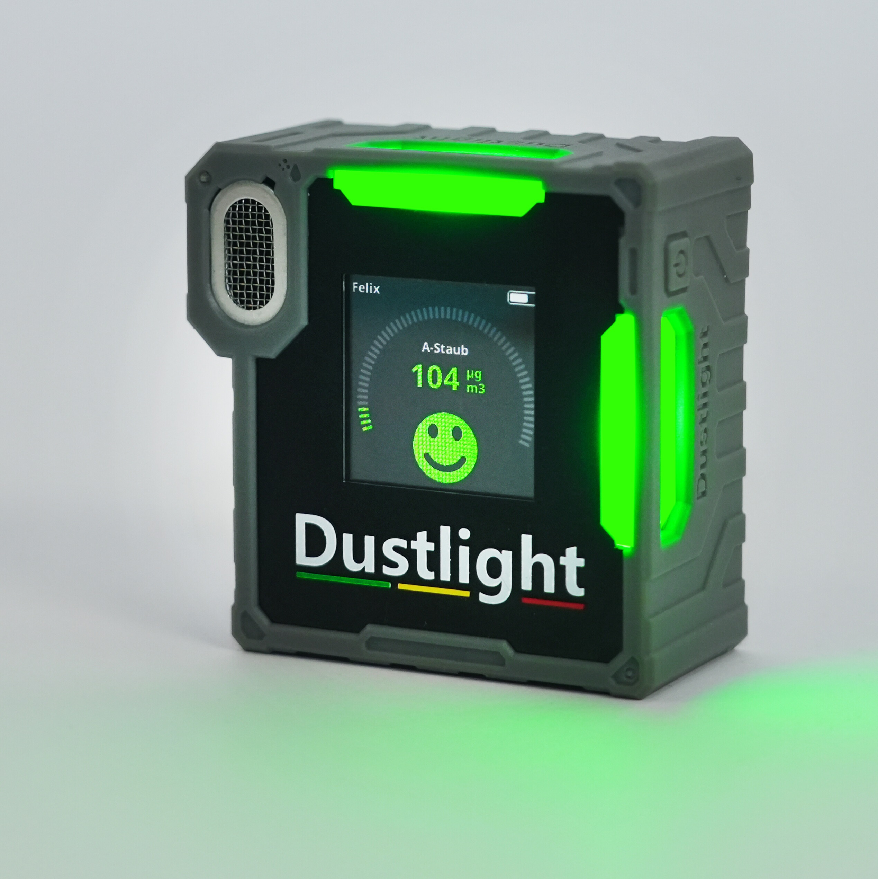
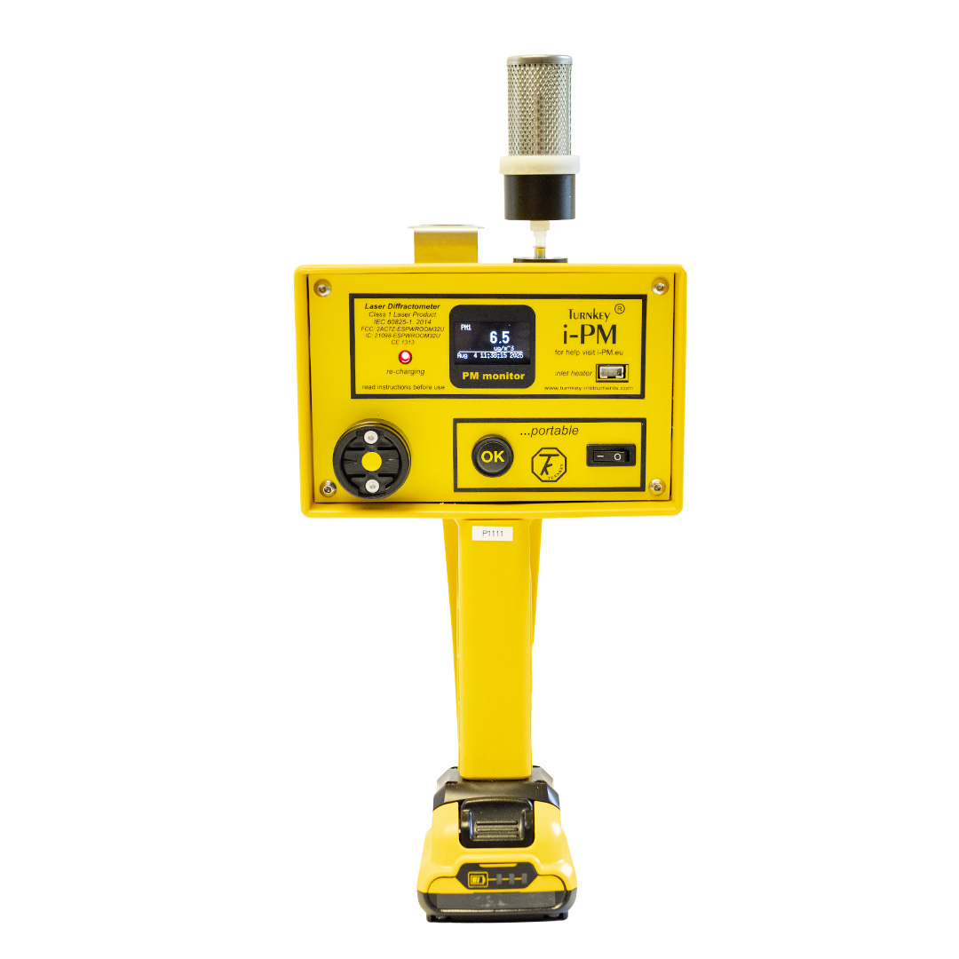
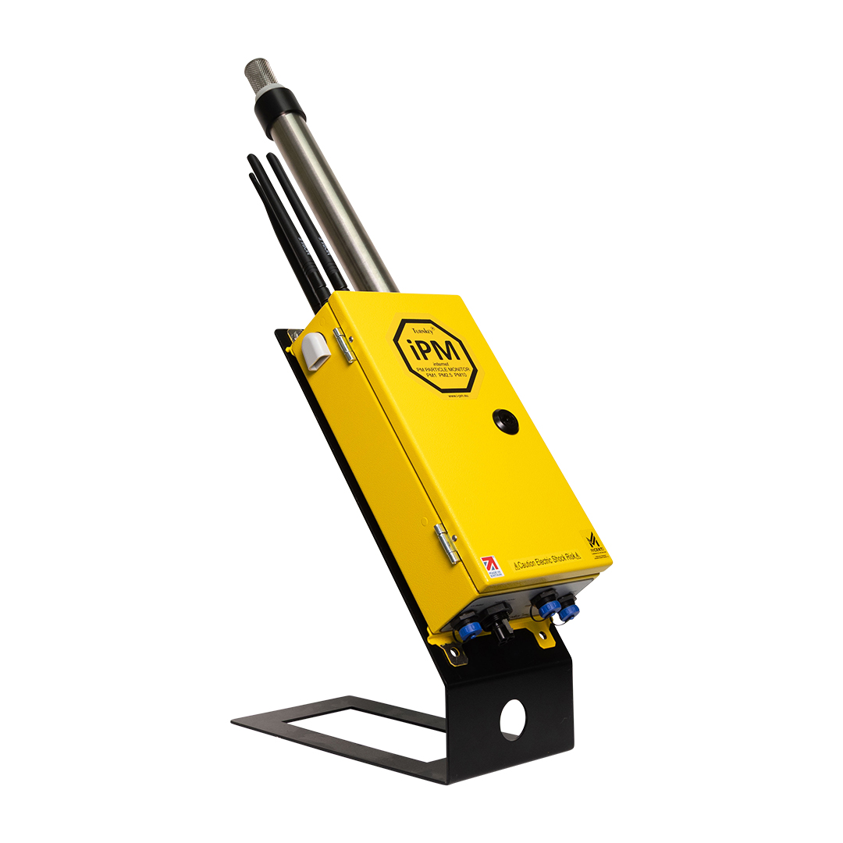
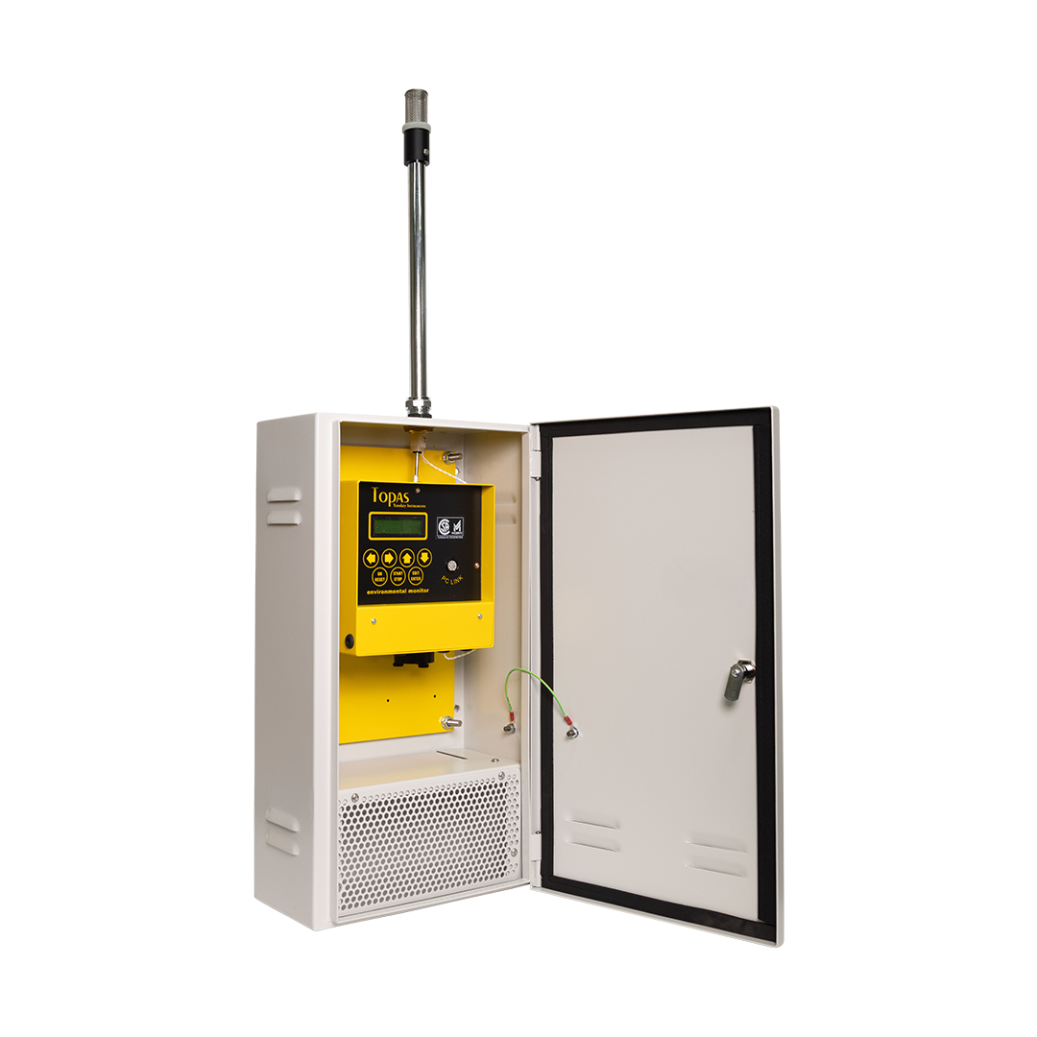
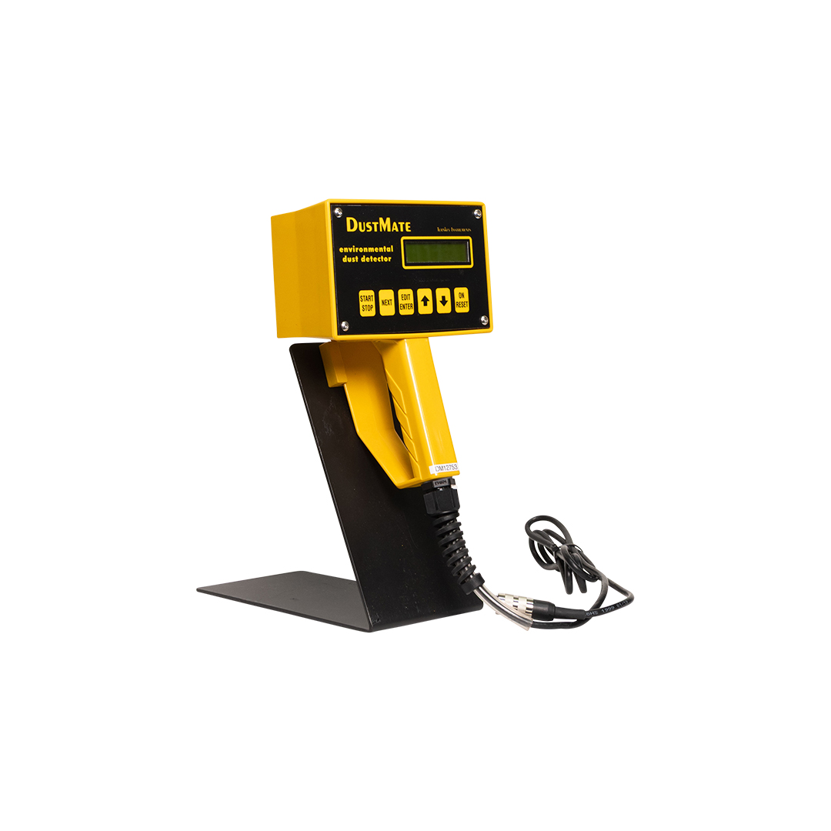


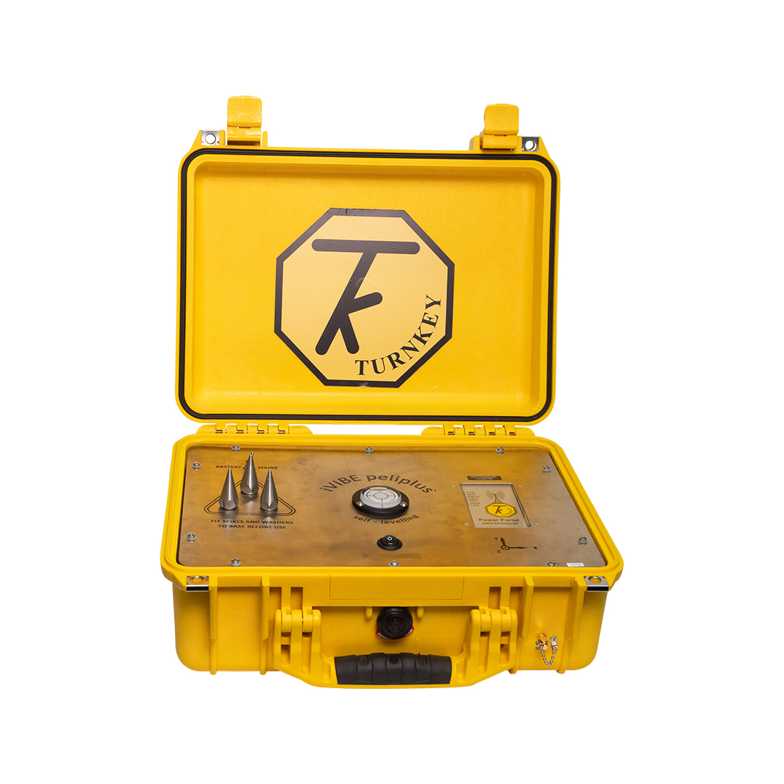
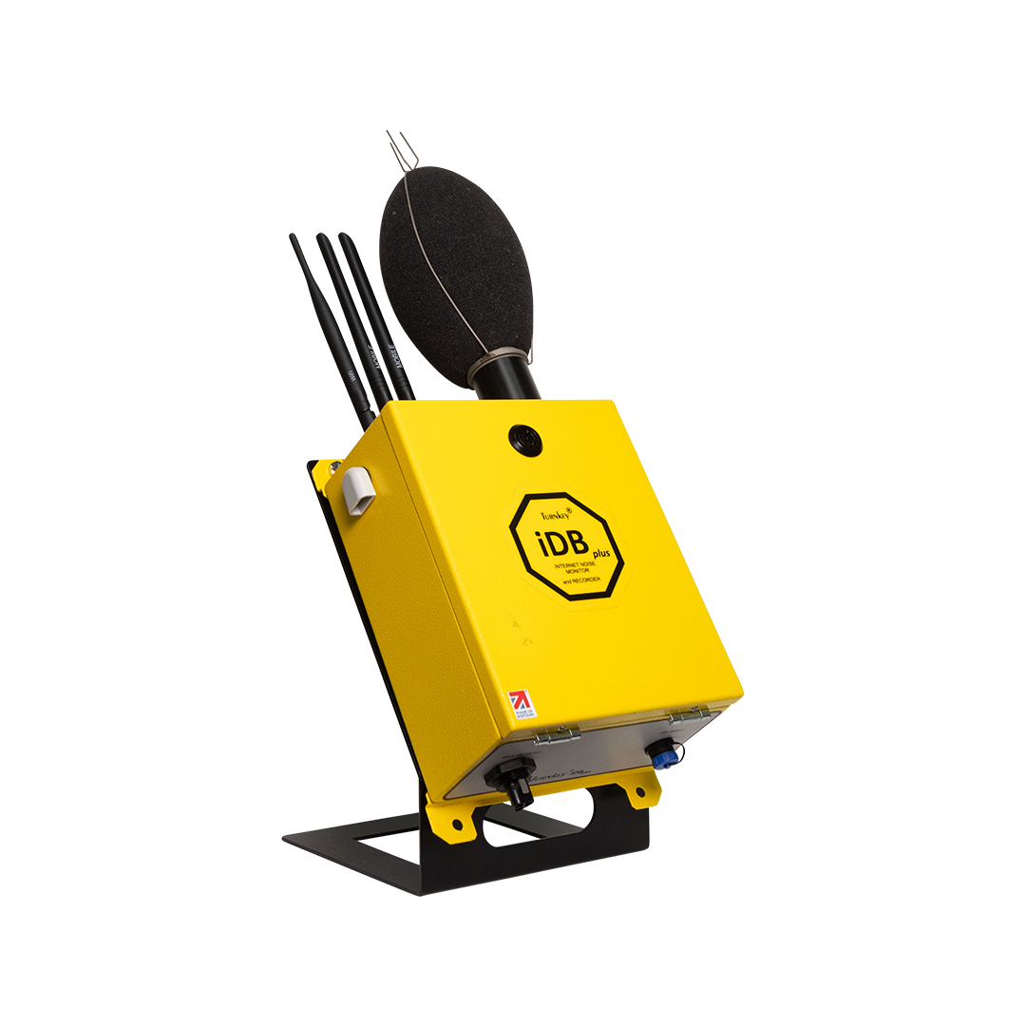
PRODUCT CATALOGUE · ENVIRONMENTAL MONITORING
16 / 22
9 PRODUCTS
See changing conditions clearly.
Dustlight – Personal Dust Monitor
iPM Portable
iPMplus
01
02
03
Topas
DustMate
Osiris
04
05
06
iGASair
iVIBEpeli
iDB
07
08
09
Notes:
Names and product images follow the current TurnKey catalogue. Product detail and compatibility are expanded in the brand hub.
[Sources]
- https://turnkey-instruments.com/product/dustlight-personal-dust-monitor/
- https://turnkey-instruments.com/product/ipm-portable/
- https://turnkey-instruments.com/product/ipmplus/
- https://turnkey-instruments.com/product/topas/
- https://turnkey-instruments.com/product/dustmate/
- https://turnkey-instruments.com/product/osiris/
- https://turnkey-instruments.com/product/igasair/
- https://turnkey-instruments.com/product/ivibe-seismic/
- https://turnkey-instruments.com/product/idb/
[/Sources]

Slide 17
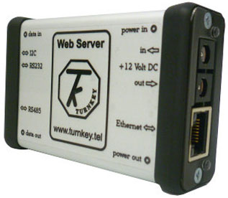
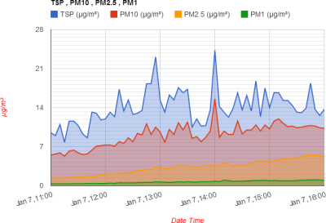
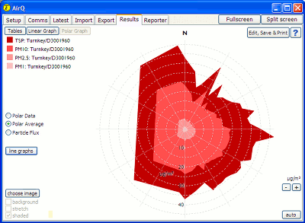
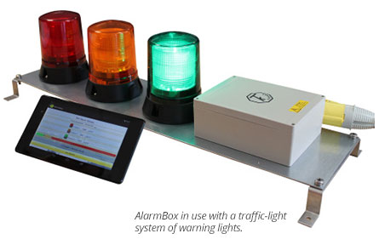
PRODUCT CATALOGUE · CONNECTED DATA + SITE RESPONSE
17 / 22
4 PRODUCTS
Turn readings into useful action.
Web Server
AirQWeb
AirQ Software
AlarmBox
01
02
03
04
INSTRUMENT
Topas / Osiris
→
CONNECTION
Web Server
→
INTERFACE
AirQWeb
→
OUTCOME
Monitor / report
Notes:
Use blue to signal the connected layer. Do not imply universal compatibility; name the product and its supported route.
[Sources]
- https://turnkey-instruments.com/product/web-server/
- https://turnkey-instruments.com/product/airqweb/
- https://turnkey-instruments.com/product/airq-software/
- https://turnkey-instruments.com/product/alarmbox/
[/Sources]

Slide 18
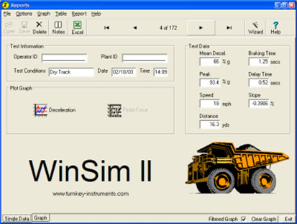
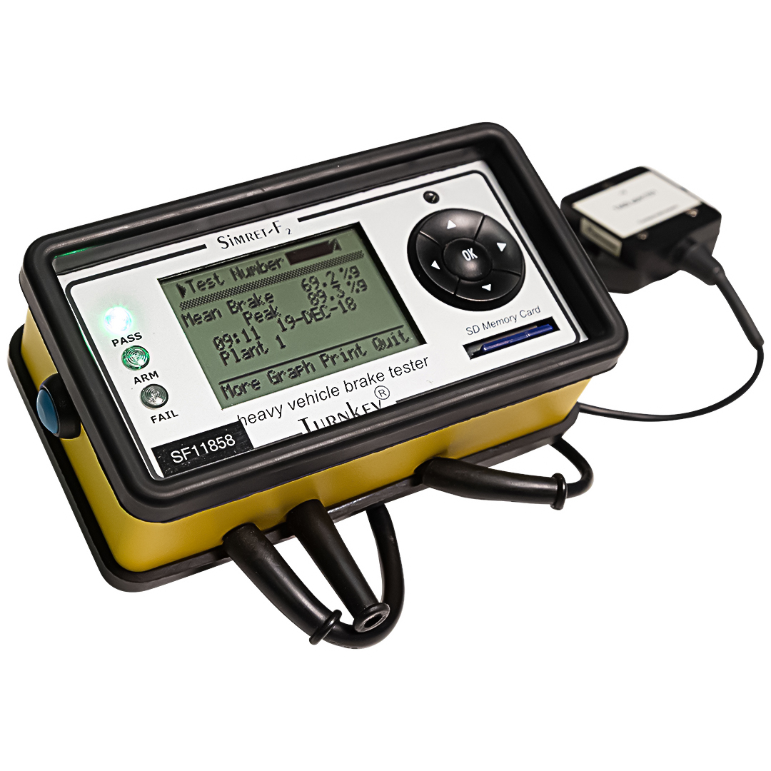
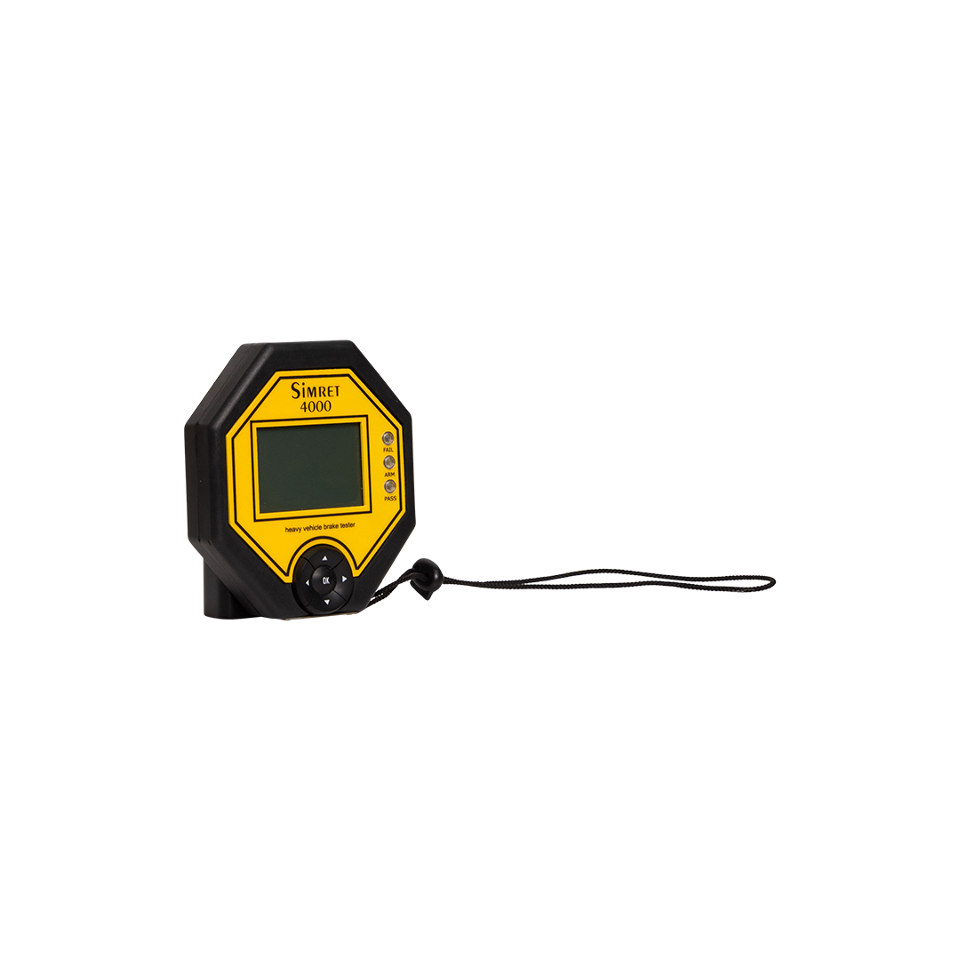
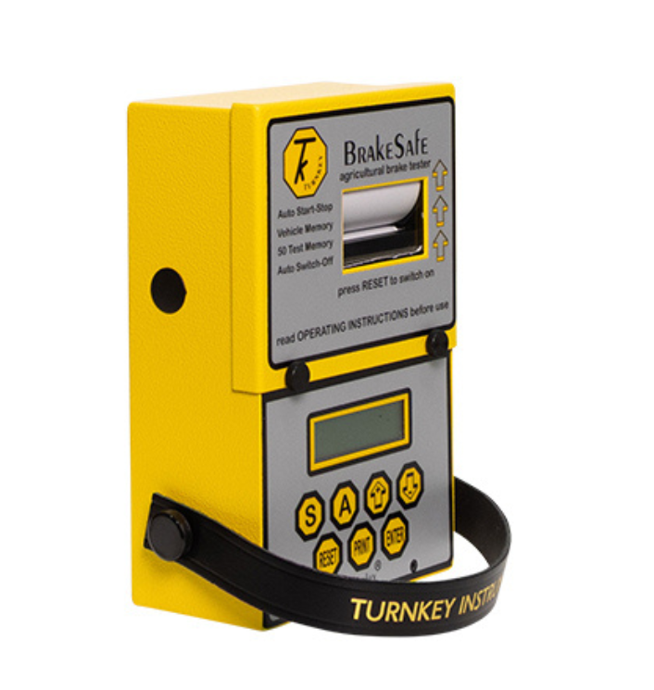
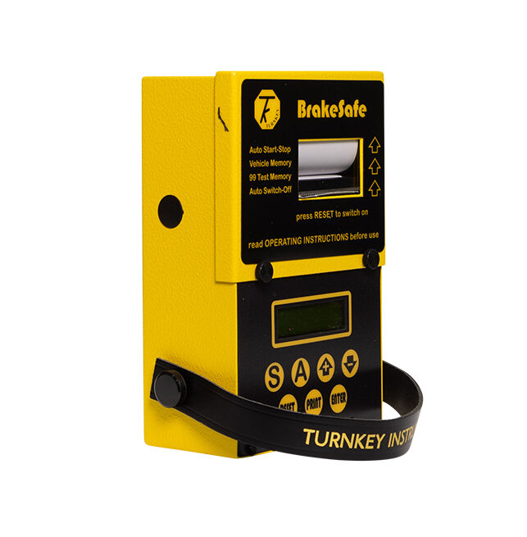
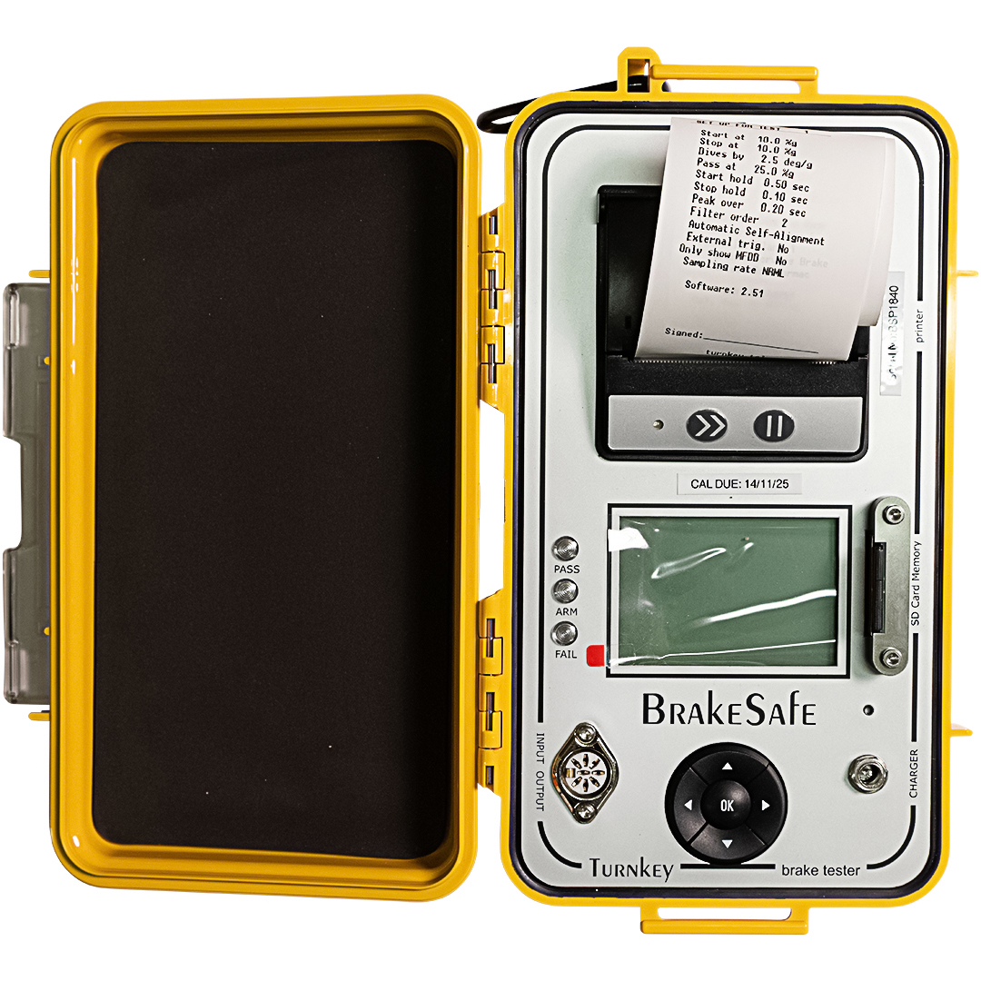
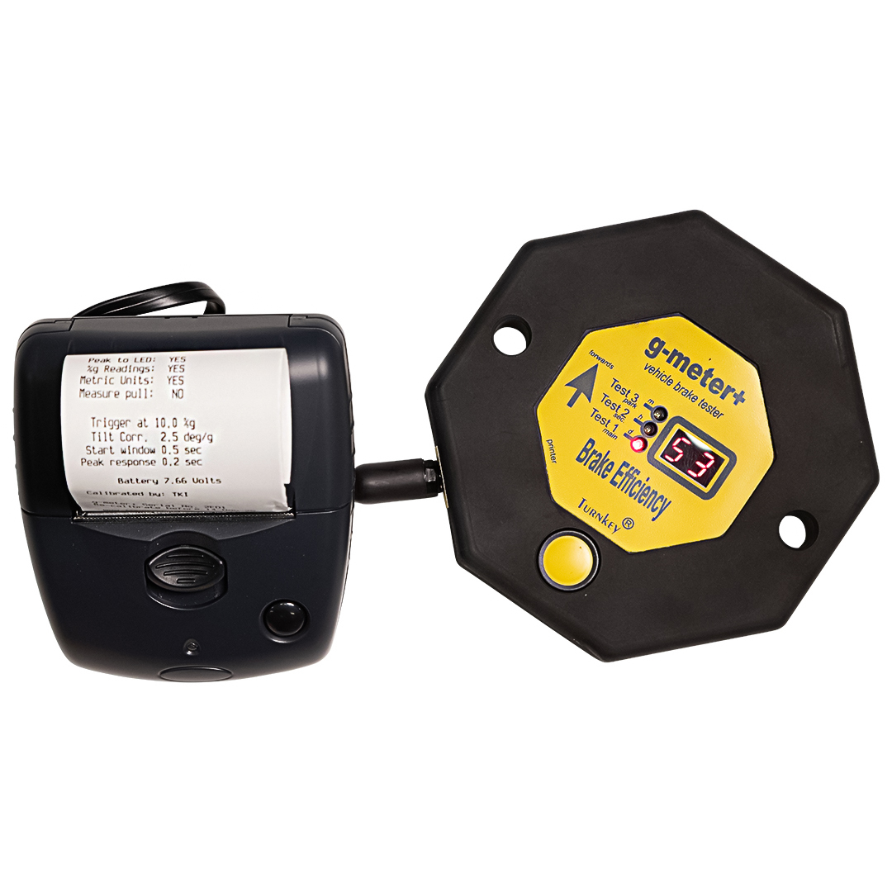
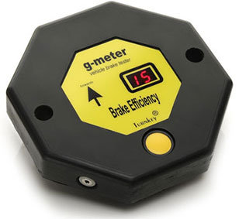

PRODUCT CATALOGUE · BRAKE TESTING
18 / 22
9 PRODUCTS
Test, record and report with confidence.
WinSim
Simret F2
Simret 4000
01
02
03
Agricultural BrakeSafe
BrakeSafe Classic
BrakeSafe
04
05
06
g-meter+
g-meter
Simret 3000
07
08
09
Notes:
The brake range includes instruments and reporting software for road, fleet, agricultural and off-road use. Keep approvals and compatibility product-specific.
[Sources]
- https://turnkey-instruments.com/product/winsim/
- https://turnkey-instruments.com/product/simret-f2/
- https://turnkey-instruments.com/product/simret-4000/
- https://turnkey-instruments.com/product/agricultural-brakesafe/
- https://turnkey-instruments.com/product/brakesafe-classic/
- https://turnkey-instruments.com/product/brakesafe/
- https://turnkey-instruments.com/product/g-meter-plus/
- https://turnkey-instruments.com/product/g-meter/
- https://turnkey-instruments.com/product/simret-3000/
[/Sources]

Slide 19
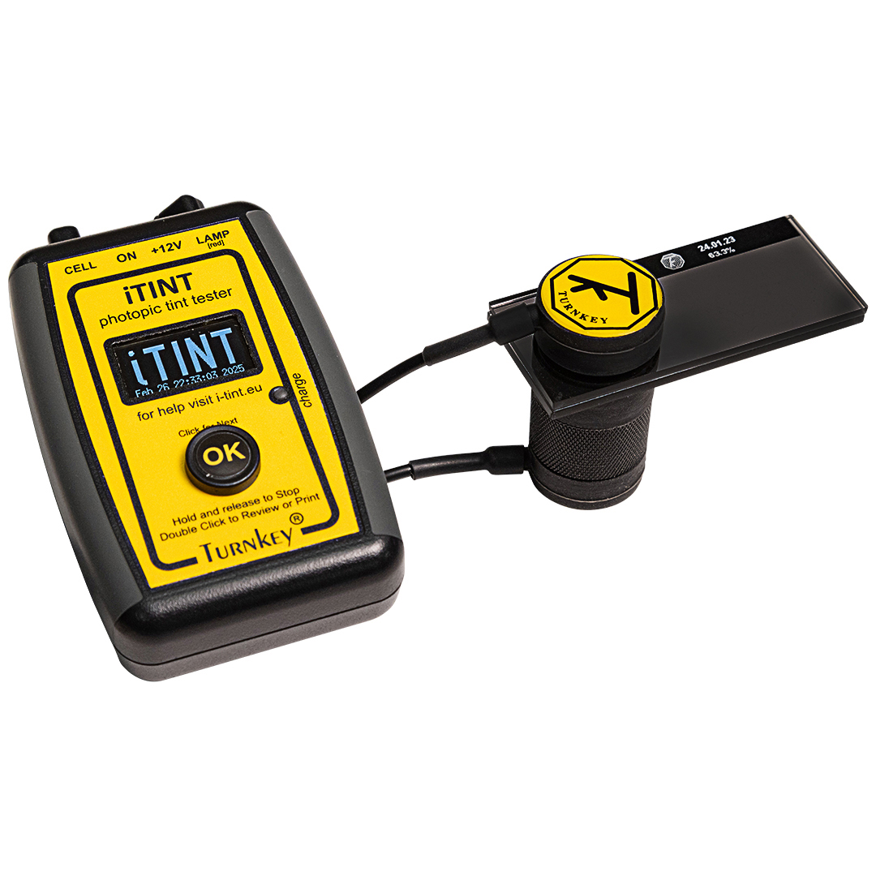
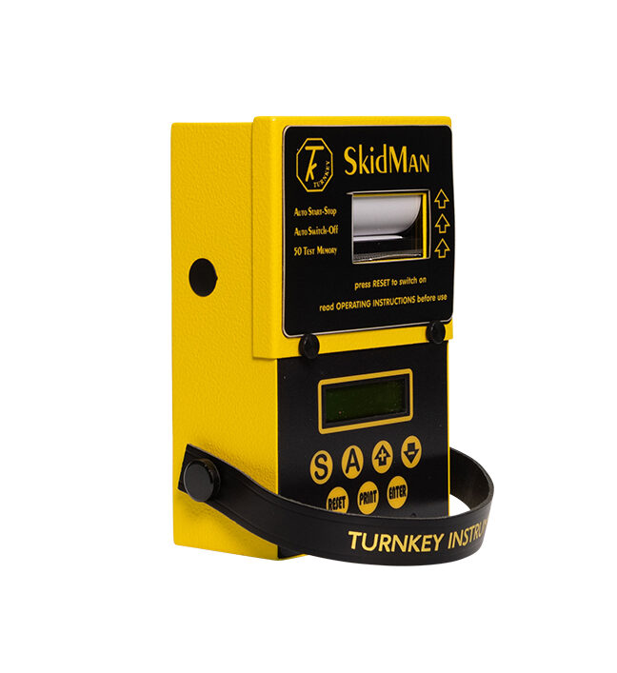
PRODUCT CATALOGUE · VEHICLE COMPLIANCE + INVESTIGATION
19 / 22
2 PRODUCTS
Focused tools for focused decisions.
PRODUCT STORY PATTERN
01
What it is
02
Where it works
03
What it connects to
04
The evidence that matters
iTINT
SkidMan
05
One clear next step
Vehicle-window tint testing.
Brake and skid testing, accident investigation and vehicle-safety inspection.
The same sequence works across every product family.
Notes:
The complete product detail is available in the brand hub. This slide shows the consistent content pattern used across the range.
[Sources]
- https://turnkey-instruments.com/product/itint/
- https://turnkey-instruments.com/product/skidman/
[/Sources]

Slide 20
APPLICATION · WEBSITE + DIGITAL EXPERIENCE
20 / 22
LEAD WITH THE DECISION
A clearer route from condition to product.
Products Applications Service
TALK TO AN EXPERT
AIR / PARTICULATE
See particulate
conditions as they change.
Find the right instrument for personal, portable or installed monitoring.
EXPLORE THE RANGE
The system makes product choice feel approachable without reducing technical depth.
Notes:
The website uses one primary action, purposeful documentary imagery and product stories that begin with the user’s condition.
[Sources]
- /Users/kristinkirchner/Library/CloudStorage/OneDrive-LocalandCo/Projects/Brand CI/TurnKey Brand Hub/public/brand/turnkey-logo.png
- /Users/kristinkirchner/Library/CloudStorage/OneDrive-LocalandCo/Projects/Brand CI/TurnKey Brand Hub/public/photography/field-monitoring-quarry.png
[/Sources]

Slide 21
APPLICATION · CONNECTED TO EVERY TOUCHPOINT
21 / 22
ONE SYSTEM, MANY FORMATS
Consistent wherever TurnKey is experienced.
DATA + SOFTWARE
DOCUMENTS + SALES
SOCIAL + CAMPAIGN
Data available.
Make site conditions measurable.
From reading to response.
Blue identifies connection, selected states and reporting.
One operational message, relevant evidence and clear navigation.
One practical idea, one decisive crop and one signal colour.
CONNECTED
PRODUCT OVERVIEW
MONITOR / ACT / PROVE
The shared hierarchy helps the brand feel established, considered and easy to trust.
Notes:
Use the same hierarchy across website, digital tools, presentations, product sheets, social and field communications.
[Sources]
[/Sources]

Slide 22
BRAND IDENTITY · 2026
Modern enough to move forward.
Familiar enough to trust.
INCLUDED
01
Complete brand hub
02
24-product catalogue
03
Logo + colour guidance
04
Typography + icon system
The refreshed system protects the recognition TurnKey already owns while creating greater clarity, consistency and confidence across every customer touchpoint.
05
Photography + tone
06
PowerPoint + PDF
LOCAL & CO · TURNKEY INSTRUMENTS
Notes:
Close on confident continuity. The supporting system is ready to use across the client-facing brand hub, presentation and PDF guide.
[Sources]
- /Users/kristinkirchner/Library/CloudStorage/OneDrive-LocalandCo/Projects/Brand CI/TurnKey Brand Hub/public/brand/turnkey-logo.png
[/Sources]

